Slide 1
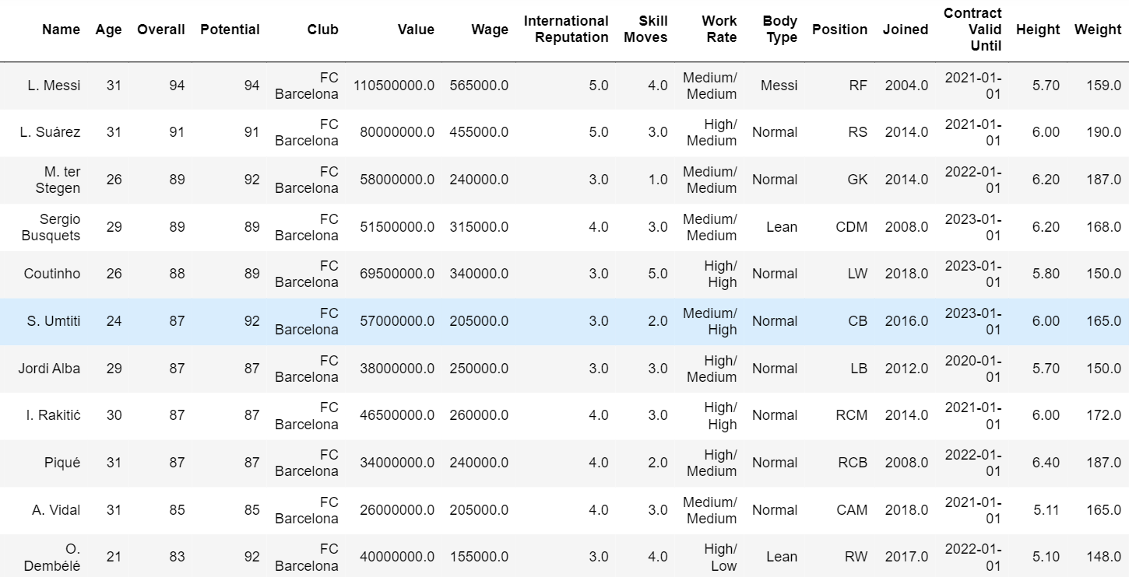
Overall score is high for FC Barcelona. overall score ranges from 61-94 while age of players is between 18 and 31.

Slide 2
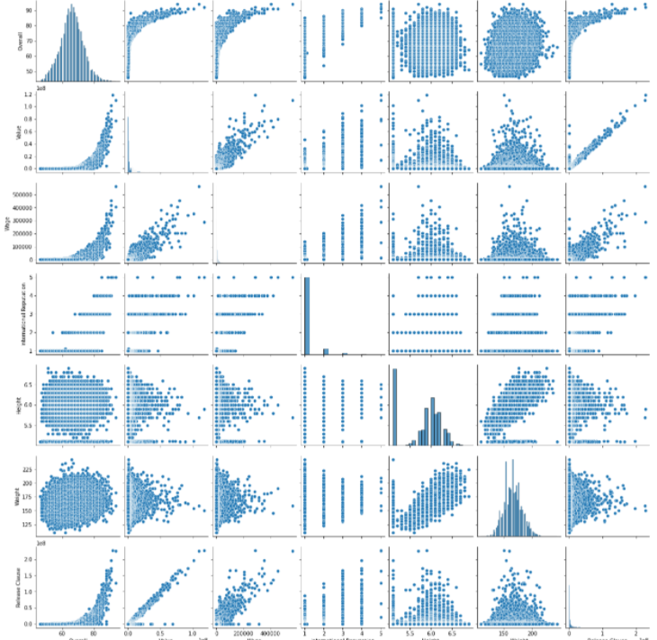
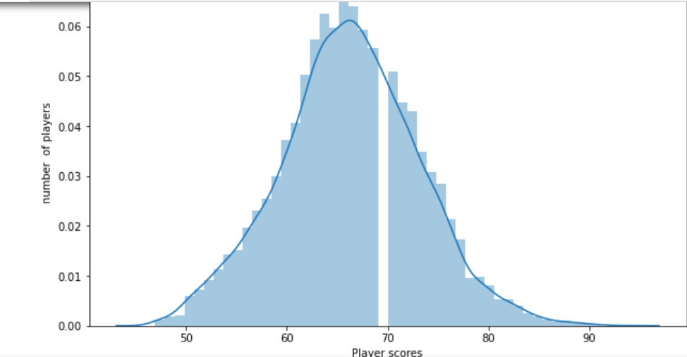
Distribution of overall score Pair plot

Slide 3
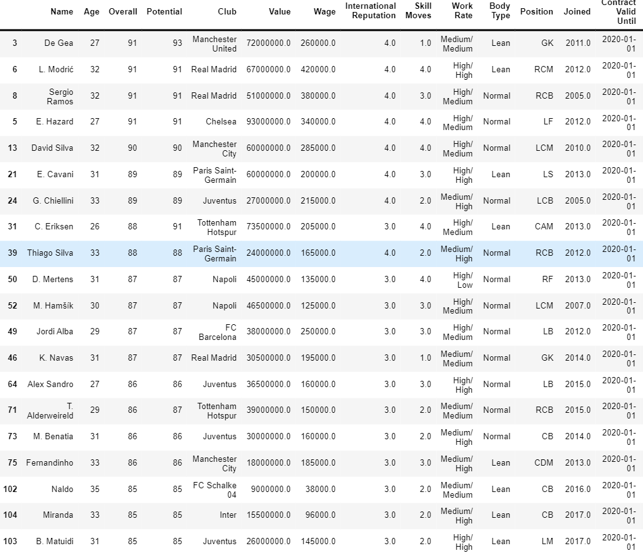
Top 20 players ranked by Overall score and whose contract expires in 2020 are shown in below figure:

Slide 4
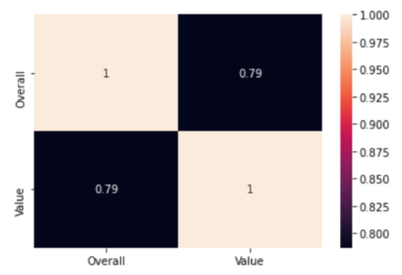
Correlation of overall score and value of top 20 players is shown from below heatmap. Overall score is highly correlated with Value with magnitude of 0.79.

Slide 5
CONCLUSION:
The data contains details for over 18,000 players playing in various football clubs in Europe. It contains information on age, skill rating, wages and player value, etc.
Data preprocessing is done by importing libraries, converting data types of several variables, dropped some columns which are not necessary, checked for missing values ,mean imputation is done for the necessary one.
Plotted distribution of Overall rating for all players. Generated pair plots for the following variables (Overall, Value, Wage, International Reputation, Height, Weight, Release Clause)
Top 20 players ranked by Overall score and whose contract expires in 2020 are tabulated in slide 3.
This data contains information about the palyers, the clubs they are currently playing for and various performance measures.
These are the conclusions made from exploratory analysis.

